Slide 1




TECH STACK
HR TECHNOLOGY
TalentForge
C++98 Standard
Core Language
Intelligent Resume Screening
& Candidate Ranking Platform
OOP Design
Inheritance · Polymorphism
STL Containers
Cohort: ADM26CCP001
vector · set · map · queue
Team: Yerramala Prathima · P Yuva Sri · Gaurav Katkar · Saurabh Jagtap
4 Members | C++98 | Console-Based Application | OOP Design
File Handling
CSV · Binary · Audit Logs

Slide 2





PROBLEM STATEMENT
Why TalentForge Was Built
Recruitment firms receive thousands of resumes monthly. Manual screening is broken:
25–40 hrs
Human Bias
No Central DB
No Audit
Poor Hires
per job role — manually
inconsistent evaluations
no candidate data store
missing compliance trail
high rejection rates
The Goal
Eliminate manual screening by introducing an automated, data-driven ranking system using core C++ concepts — delivering objective, bias-free shortlists in minutes, not hours.

Slide 3

SYSTEM ARCHITECTURE
5 Core Modules via ScreeningManager
01
02
03
04
05
Resume
Ingestion
Job
Description
Skill
Matching
Rank &
Shortlist
Export
& Log
→
→
→
→
parseResumeFile()
set<string> skills
from resumes/*.txt
map<string,int>
requiredSkills
weight sum = 100
calculateScore()
case-insensitive
keyword match
priority_queue
ScoreComparator
top-N extract
screening_results
shortlist.log
backup.dat
ScreeningManager — Facade class orchestrating all modules via a 10-option menu-driven console. Clean separation of concerns. Zero coupling between modules.

Slide 4
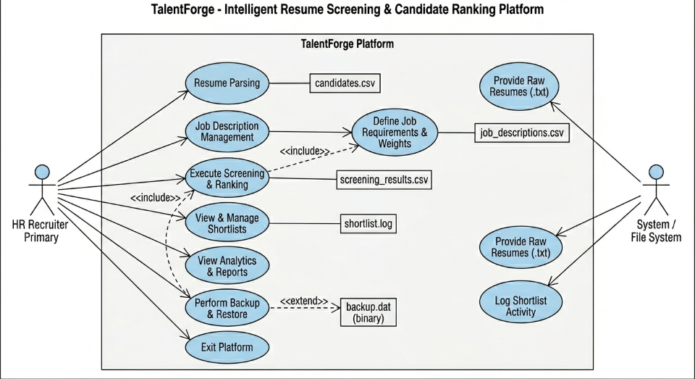
USE CASE DIAGRAM

Slide 5
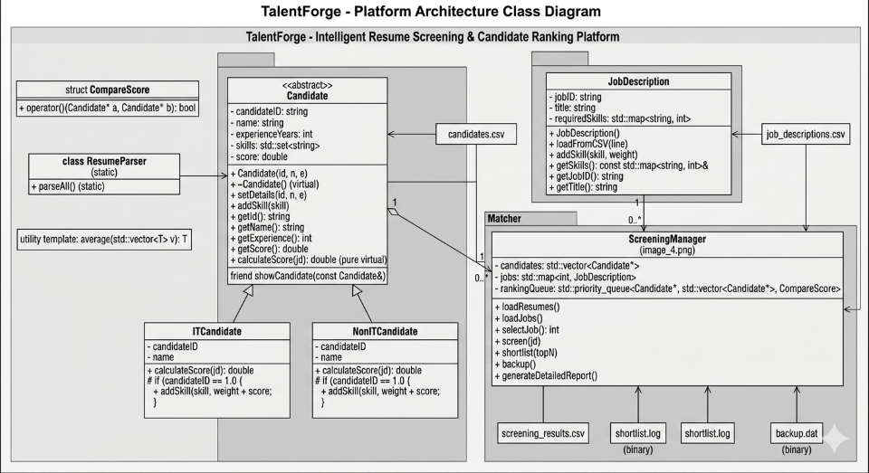
CLASS DIAGRAM

Slide 6
OOP DESIGN & SCORING
Class Hierarchy & Scoring Formula
Candidate (Abstract Base Class)
SCORING FORMULA — IT Candidate
virtual calculateScore() = 0 | virtual getCandidateType() = 0
normalizedScore = (Σ matchedSkillWeight
/ totalWeight) × 100
ITCandidate
NonITCandidate
expBonus = min(experienceYears × 2.0, 10.0)
primaryTechStack
certifications
skillMatch + expBonus
+ certBonus (capped 100)
domain
languages
skillMatch + expBonus
+ domainBonus (capped 100)
certBonus = certifications.empty()?0.0:5.0
finalScore = min(normalizedScore + expBonus
+ certBonus, 100.0)
Encapsulation
Inheritance
Polymorphism
Abstraction
Component
Formula
Max Points
Skill Match
(matched÷total)×100
~100
STL Components:
Exp Bonus
min(yrs×2, 10)
+10
vector<Candidate*> · set<string> · map<string,int> · priority_queue
Cert Bonus
if certified
+5
Algorithms: sort · find_if · accumulate · for_each · copy_if
Final Score
capped at 100
≤ 100

Slide 7


BUSINESS & ACADEMIC IMPACT
Why TalentForge Works
80%
5000+
100%
Zero
Faster Screening
Resumes Processed
Bias Eliminated
External Libraries
Fast
Scalable
STL priority_queue enables instant top-N shortlisting with O(log n) operations
New candidate types added via inheritance — zero refactoring of existing code
Audit-Ready
Academically Strong
Append-only shortlist.log with timestamps ensures full compliance traceability
Complete C++98 mastery: OOPS, STL, File Handling, and Exception Handling

Slide 8

CONCLUSION
Key Takeaways
TalentForge
Processes 5,000+ resumes efficiently
Domain: HR Technology & Recruitment Automation
A Complete Software Engineering Solution
Rule-based scoring eliminates human bias
TalentForge bridges academic theory and real-world engineering using pure C++98 — showcasing clean architecture, advanced STL, robust OOP design, and complete file handling to solve a large-scale business problem.
Full audit trail for compliance
Extensible OOP inheritance hierarchy
Cohort: ADM26CCP001
Pure C++98 — zero external dependencies
Ideal for final evaluation

